Slide 1
Inferential Statistics

Slide 2
The story so far..
Types of variables
Scales of Measurement
Central Tendency
Spread of Data
Basic Graphs
Probability
Probability Distributions

Slide 3
Central Limit Theorem

Slide 4
Central Limit Theorem
Consider a distribution with mean μ and variance σ²
Let us take a sample of size N from the distribution
Let us take many such samples of size N and make a sampling distribution
The sampling distribution approaches normal distribution with mean μ and variance σ²/N and N increases
Notes:
Note that the original population distribution may not be normally distributed but the sampling distribution will be normally distributed given that N is large enough

Slide 5
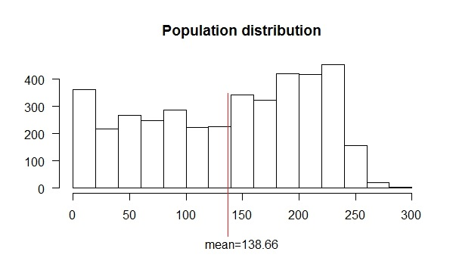
CLT - Illustration

Slide 6
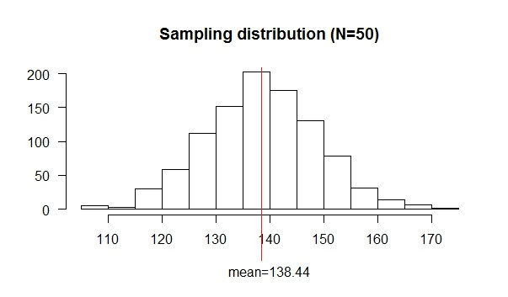
CLT – Illustration (contd.)

Slide 7
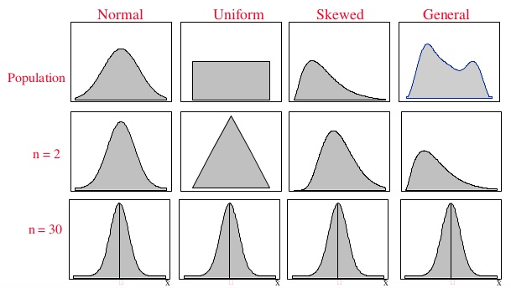
CLT – Illustration (contd.)
http://www.slideshare.net/ShakeelNouman1/sampling-and-sampling-distributions
Notes:
From this figure, we can infer that whatever be the population distribution, the sample distribution will become normal when N becomes sufficiently large

Slide 8
Implications of CLT
Whenever we take a sample statistic from a sample of sample size N from a population with mean μ and variance σ², we can assume that:
The sample statistic is from the sampling distribution which is normally distributed
The mean of the sampling distribution is μ
The variance of the sampling distribution is σ_{m}² = σ²/N
This means that the mean of a sample statistic of sample size of N will be within 2 standard deviations (2σ_{m}) of original population mean μ
Notes:
This property is very helpful in statistical hypothesis testing. Normally distributed means roughly 95% of samples will lie within 2 standard deviations

Slide 9
Statistical Hypothesis Testing

Slide 10
Statistical Hypothesis
Statistical Hypothesis is an assumption about a population parameter
The assumption may or may not be true
Examples:
The mean length of the chocolate bars produced in the factory is 5 cm
The mean age of all learning data analytics course is 24.3 years
The proportion of women among learners of data analytics is 76 percent
The mean weight of cricket balls produced by two machines are equal
Notes:
We all know the proportion of women is false. How? Because in the classroom we have a sample from the population. The sample suggests that the proportion of women learning data analytics is very small. This is exactly what we are going to do with statistical tests. We state a hypothesis and we look at a sample from the population and find out the probability of seeing such a sample if the hypothesis were true. If our hypothesis that 76 percent of data analytics learners were true, the probability of you sitting in a such a class with very few or no girls is very low. So what we do? We reject our hypothesis that 76 percent of data analytics learners are female. We will see in the subsequent lectures how to do this statistically. In confidence intervals we started off with no idea bout the population statistic. we found the sample statistic and since there was some uncertainty, we added some cushion on both sides and said we are pretty sure that the population statistic should lie within the interval. In hypothesis testing, we make some assumptions before looking at the sample statistic and based on the sample, we make a decision whether to reject the hypothesis or not

Slide 11
Null and Alternate Hypothesis
Null hypothesis is the initial claim or the default position
It is denoted by H0
Alternate hypothesis is the rival of the null hypothesis
It is denoted by H₁ or H_{A}
For example, in the chocolate bars manufacturing case, the null hypothesis is that the mean length of the chocolate bars produced is 5cm. Alternate hypothesis is that the mean length is not 5 cm
H₀: μ = 5
H₁: μ ≠ 5
Notes:
Here μ is the population mean i.e. the average length of all the chocolate bars produced by the factory

Slide 12
Null and Alternate Hypothesis (contd.)
In the example about the proportion of data analytics learners, the null hypothesis is that the proportion of women among data analytics learners is 0.76
The alternate hypothesis is that the proportion of women is not 0.76
H₀: P = 0.76
H₁: P ≠ 0.76
Notes:
Here P denotes the proportion

Slide 13
Null and Alternate Hypothesis (contd.)
We try to prove the alternate hypothesis
If the alternate hypothesis is proved, we reject the null hypothesis
If the alternate hypothesis is disproved, we fail to reject the null hypothesis
If the alternate hypothesis is disproved, we don’t say we accept the null hypothesis instead we say there is not enough evidence to reject the null hypothesis

Slide 14
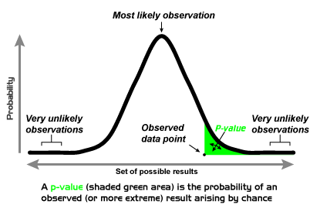
p-value
p-value is the probability of obtaining a sample statistic equal to or more extreme than the observed value given that the null hypothesis is true
https://en.wikipedia.org/wiki/File:P-value_Graph.png
Notes:
Remember from CLT that sample statistic is part of sampling distribution with mean equal to the population mean. Now our sample statistic is the little dot in the picture. P-value is the probability of finding such a sample statistic which is the area shaded in green

Slide 15
p-value (contd.)
Let us design an experiment to decide whether a coin is fair or biased
H0: Coin is fair (p(H) = 0.5)
H1: Coin is biased (p(H) ≠ 0.5)
Let us start the coin and find the p-value i.e. the probability of getting the result in the observation
Notes:
In the case of proportion of women data analytics learners, p-value is the probability finding a sample is with 0.1 (or whatever value) proportion of women if the true population proportion i.e. the total population proportion of women learners is 0.76
If it is a fair coin, the probability of head is equal to the probability of tail which is equal to 0.5
Remember that the null hypothesis is coin is fair so the probability of head is .5. Let us say we get one head in the first trial. And in the second trial also a head and in the third trial and so on..
Now we realise that something is wrong. If the coin is indeed fair, we shouldn't have got 5 heads in a row right. Now if the P value is below 0.05, we feel something is wrong with the null hypothesis and reject it. This value is called the significance level

Slide 16
Significance Level
Significance Levels (α) refers to the predefined probability to compare the p-value
If the p-value is less than α, we reject the null hypothesis
If the p-value is not less than α, we fail to reject the null hypothesis
We say that we have achieved a statistically significant result if the p-value is less than α
Typical significance level is 0.05 (5%)
Sometimes .01 (1%) is used as a significance level
Notes:
When we use 0.01 as alpha, we are little liberal with the null hypothesis since the chance of rejecting the null hypothesis is lower compared to 0.05 alpha

Slide 17
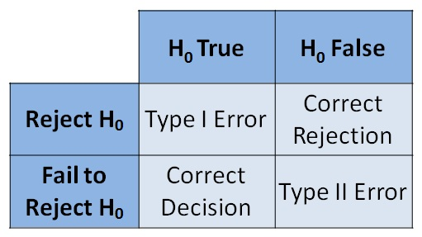
Type I and Type II Errors
http://whatilearned.wikia.com/wiki/File:Type_I_and_Type_II_Error_Table.jpg

Slide 18
One-tailed and two-tailed tests
One-tailed test allows you to determine whether a sample statistic is greater than or less than a certain value
Here we are interested in one direction
The direction has to be chosen before the test
Example:
A chips manufacturer claims that the average amount of saturated fat in a packet of chips is no more than 10g
H₀: μ = 10, H₁: μ > 10
We are interested only in one direction i.e. whether the fat content is more than 10 g

Slide 19
One-tailed and two-tailed tests (contd.)
Two-tailed test allows you to determine whether a sample statistic is not equal to a certain value
Here we are interested in both the directions i.e. the sample statistic is greater or less than a certain value
Example:
A cricket ball manufacturer says the average weight of the ball produced by them is 161 gm
H₀: μ = 161, H₁: μ ≠ 161
We are interested in both directions i.e. whether the ball is heavier or lighter than 161
Notes:
Since cricket ball has to weigh between 155.9 and 163.0 gm. We have problem if the ball is heavier or lighter unless the chips example where we have problem only when the fat is higher than 10g and we are good if the fat is less than 10g

Slide 20
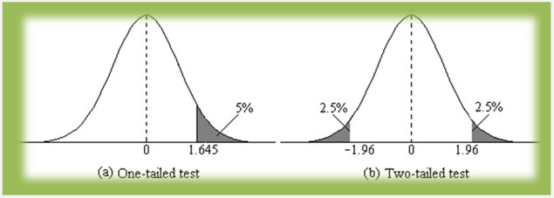
One-tailed and two-tailed tests (contd.)
Notes:
In one sided, if the hypothesis is that the mean value is greater than then we look at the grey shaded area(right tail test). If the hypothesis is that the mean value is less than, then we take the unshaded area or we can take (1-shaded area) (left tail test). In two sided case, the hypothesis is that the mean value is equal to some value and hence we take both the sides

Slide 21
One-sample, two-sample and paired tests
When a sample statistic is compared with a single value, one-sample test is used
e.g. Average weight of cricket ball produced is 161 g
H₀: μ = 161, H₁: μ ≠ 161
When two sample values are compared and the two samples are independent of each other, two-sample test is used
e.g. Lets say there are two machines in the company which produces cricket balls and we need to find whether the weight of the cricket balls produced by these two machines differ
H₀: μ₁ = μ₂, H₁: μ₁ ≠ μ₂
Notes:
Here we aren't comparing the means with a single value. Instead, we are comparing the means with each other. Also, the weight of cricket balls produced by the two machines are independent of each other

Slide 22
One-sample, two-sample and paired tests (contd.)
When two sample values being compared are dependent on each other, paired test should be used
e.g. Let us say we want to study whether a particular drug reduces blood glucose level.
We take 100 persons and record their blood glucose levels before and after taking the drug.
Now we have to compare blood glucose levels before taking the drug and after taking the drug

Slide 23
One-sample, two-sample and paired tests (contd.)

Slide 24
One-sample, two-sample and paired tests (contd.)
H₀: μ₁ = μ₂
H₁: μ₁ ≠ μ₂
Here in each observation, the blood glucose levels before and after are related to each other
If the blood glucose level is relatively higher before drug, the blood glucose level after drug will also be relatively higher
Since each pair of observation is dependent on the other, we use paired test here
Notes:
μ₁ = μ₂ (average blood pressure before and after the drug are equal i.e. the drug has no effect on blood pressure)

Slide 25
Steps in hypothesis testing
State the null hypothesis H₀ and the alternate hypothesis H₁
Select the appropriate level of significance α
Calculate the test statistic, p-value
Compare test statistic with alpha
Make a decision about null hypothesis H₀

Slide 26
One Sample Tests

Slide 27
One sample tests
One sample t-test
One sample z-test
Chi-square test for variance
One sample proportion test
Notes:
We are going to study these tests, under what conditions these tests should be used and we are also going to see how to do these tests in R

Slide 28
One sample t-test
Used to test population mean μ
Population standard deviation is unknown
Sample size is small (n < 30)
Example:
Given below is the weight of 8 sample cricket balls produced by a factory
160.39, 160.64, 160.13, 160.53, 160.86, 161.89, 160.51, 162.43
With this sample data, we want to check whether the average weight of the cricket ball produced by the factory is equal to 161 g

Slide 29
One sample z-test
Used to test population mean μ
Population standard deviation is known
If the sample size is large (n ≥ 30), population standard deviation is approximately equal to the sample standard deviation (σ ≈ s)
Example:
Suppose we need to find out whether the mean height of 12-year old boys in India is 150cm
We take 1000 random samples from all over India
Notes:
In most practical cases, we don’t know the standard deviation of the population. The catch here is if we know the standard deviation of the population, we would have definitely known the mean of the population and hence there is no need for the test (as we already know the true population mean). If the sample size is large, we can approximate the sample standard deviation as the population standard deviation and use the z-test.
Here we can use z-test since the sample size 1000 is greater than 30

Slide 30
Chi-square test for variance
Used to test the population variance (or standard deviation)
Sample variance is calculated and compared with the hypothetical value of population variance
Example:
Let us assume that, in the previous example, the population standard deviation of height of boys aged 12 is 2.6 cm
Sample variance of 1000 boys aged 12 years can be calculated from the data
From this, hypothesis on population variance can be tested

Slide 31
One sample proportion test
Used to test population proportion or probability
Example:
We are interested in finding out whether a candidate in an election will get more than 55% of votes
Null hypothesis is that the population proportion who would vote for our candidate is 0.55
H₀: p > 0.55, H₁: p ≤ 0.55
We take a random sampling of 1000 voters and 513 of them said they will vote for the candidate

Slide 32
Two Sample Tests

Slide 33
Two sample tests
Two sample t-test
Two sample z-test
Paired t-test
Two sample proportion test
F-test
Notes:
We are going to study these tests, under what conditions these tests should be used and we are also going to see how to do these tests in R

Slide 34
Two sample t-test
Used to test whether there is any significant difference between two population means
Example:
We want to find whether there is any significant difference between the mean weight of cricket balls produced by two machines in a factory
Samples from each machine is taken
Sample 2 from Machine 1: 159.17, 159.86, 159.77, 161.19, 159.25, 159.31, 161.75, 160.45, 162.80, 159.54
Sample 2 from Machine 2: 154.47, 159.66, 161.11, 160.82, 161.49, 159.16, 158.89, 163.73, 160.77, 158.20

Slide 35
Two sample z-test
Used to test whether there is any significant difference between two population means
Example:
Suppose we want to find out whether there is any significant difference between the mean heights of 12 year old boys and 12 year old girls in the country
1000 random sample heights of both 12 year old boys and girls are taken across the country

Slide 36
Paired t-test
Used to test whether there is any significant difference between two population means where the samples are dependent on each other
Example:
We are interested in finding whether a particular drug changes the blood glucose level
We take blood glucose level of 25 persons and administer the drug to them
Blood glucose level is taken after the drug is administered

Slide 37
Two sample proportion test
Used to test whether the difference in two proportions is significant
Example:
Two machines produce cricket balls in a factory, some of which are defective
We are interested in testing whether there is a significant difference between the proportion of defective balls produced by the 2 machines
Null hypothesis is that the proportion of defective cricket balls is the same
H₀: p₁ = p₂, H₁: p₁ ≠ p₂
Machine 1 gave 31 defective balls out of 250 and machine 2, 42 out of 300

Slide 38
F-test
Used to test the variance of two samples
Samples should be normally distributed
Example:
Let us consider the mean height of 12 year old boys and girls
We know that the height of a population is normally distributed
We are interested in the variance in height among the boys and girls

Slide 39
Multi Sample Tests

Slide 40
Multi sample tests
ANOVA (Analysis of Variance)
Chi-square test for independence
Notes:
We are going to study these tests, under what conditions these tests should be used and we are also going to see how to do these tests in R

Slide 41
ANOVA
Also known as Analysis of Variance
Used to compare three or more means
Example:
For example, in the height of 12 year old boys case let us say we need to find whether there is any difference between the mean of boys from different states
For single step multiple comparison, Tukey HSD test is used

Slide 42
Chi-square test of independence
Used to evaluate the relationship between variables i.e. whether variables are independent or there is a dependency between them
Example:
Consider the following table which gives the colour preference for boys and girls
We are interested in knowing whether there is a relationship between colour preference and gender

Slide 43
Chi-square test of independence (contd.)
Here we have two variables gender and colour preference
The null hypothesis:
H₀: The variables gender and colour are independent of each other
The alternate hypothesis:
H₁: The variables gender and colour are dependent on each other

Slide 44
Confidence Intervals
Notes:
So far we have seen hypothesis testing where we make a statement or hypothesis and go ahead and test our hypothesis. In interval estimation, we don’t have a hypothesis instead we make estimation about the population statistic with the sample statistic. In hypothesis testing, we start with an estimate and calculate the probability where as in interval estimates, we start with a probability and end up with a range of estimates.

Slide 45
Confidence Interval for Means
Consider a machine in a chocolate factory which produces bars of chocolates
We are interested in the average length of each bar of chocolate
Sample Mean = 4.95
… 5.23, 5.04, 4.94, 4.97, 5.02, 4.78, 5.25, 5.17, …
Sample Mean = 5.04
How confident or sure are we about sample average being equal to the true average of the chocolate bars?
Notes:
Length of the chocolate bars is given in cm
Let us say the machine produces 1 million chocolate bars per day. It is not possible to measure each and every bar and find the average
So we take a sample from the population
There is an uncertainty associated with sample statistic
different samples will give different estimates and this is called sampling error or variation due to sampling
Can we express the estimate as a range within which we are pretty sure that the true population parameter lies
I don’t know the true average (population average) but I am pretty sure that the true average lies between 4.9 and 5.1 cm
we want to express the estimate as a range within which we are pretty sure that the true population parameter lies
Or I am 90% confident that the true average lies between 4.9 and 5.1 cm
How to do this statistically?

Slide 46
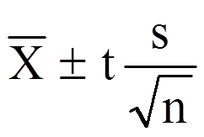
Confidence Interval for Means (contd.)
Confidence Intervals helps us describe the amount of uncertainty associated with a sample estimate
It is an interval estimate combined with a probability statement
s/√n is called the standard error
Notes:
X bar is the sample estimate, n is the sample size and s is the sample standard deviation
t score has to be calculated from the t-distribution table or using R

Slide 47
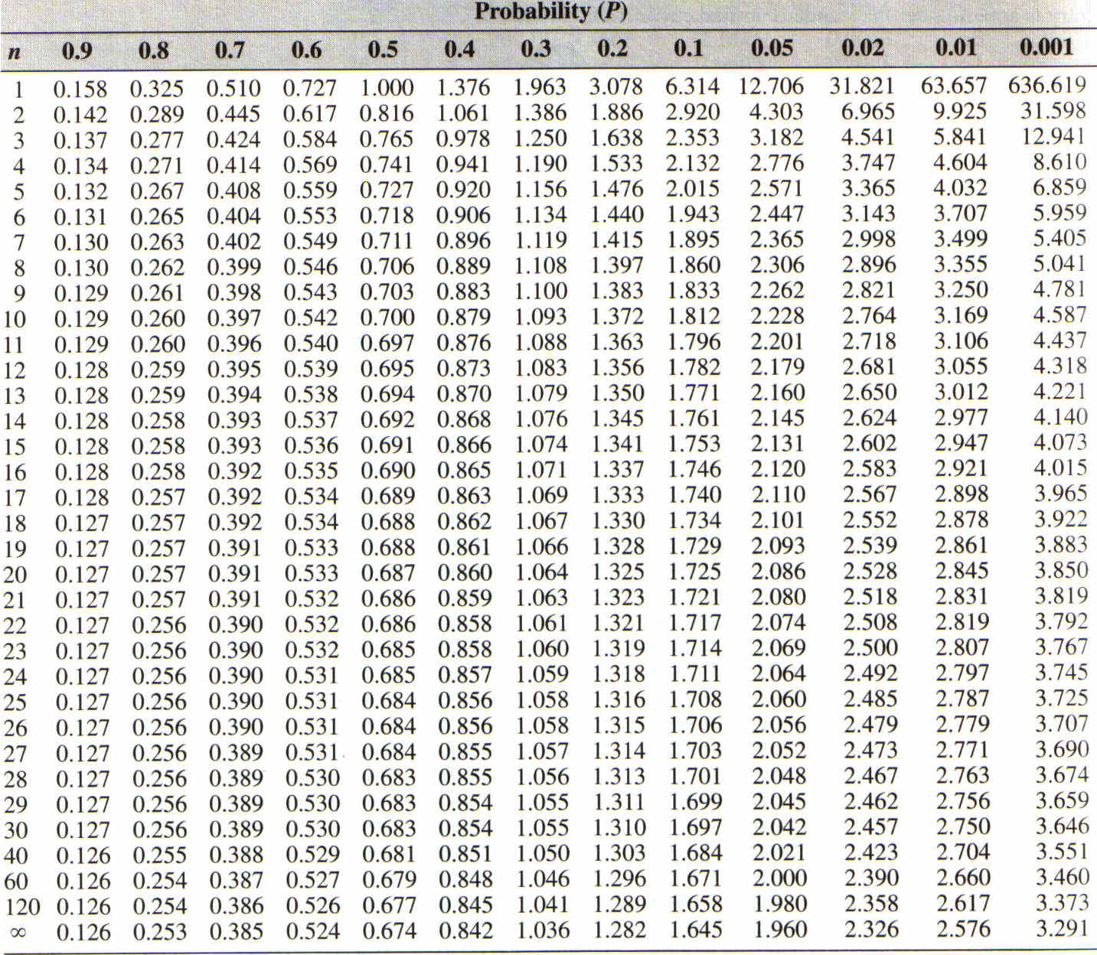
T-Distribution Table
Notes:
How to calculate the t-value
n is the degrees of freedom. So for a sample size of 5, we need to look at 4 since 4 is the degrees of freedom
For 90% confidence interval, we need to look at 1-.9 = .1
So, our 90% confidence interval is 4.95 and 5.13

Slide 48
Interpreting Confidence Intervals
Confidence Intervals communicate how accurate our estimate is likely to be
A 95% confidence interval means that if we use the same sampling method to select different samples and compute the interval estimate for each sample, we would expect the true population estimate to fall within the interval estimates 95% of the time

Slide 49
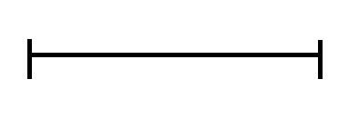

Interpreting Confidence Intervals (contd.)
Notes:
How to correctly interpret confidence intervals?
The big line represent the population and the vertical line is the mean of the population which is what we are trying to estimate
Lets take a sample and find a 95% confidence interval. The true mean lies within the interval
Lets take another one and another one.. Few of them doesn’t contain the true mean
90% confidence interval means 90% of the times the interval will contain the true mean
Similarly explain for 80% and other percentages
width of the confidence interval depends on the variance within the population of
interest and the size of the sample
variance within population: if all the values in the population are almost the same, then
our sample will also have little variation. any sample we take is likely to be pretty
similar to any other sample. our estimate is going to be pretty close to the true
population value. in this case we would have a small confidence interval. But a more
varies population leads to a more varied sample. Different population will differ more.
We would be less sure that the sample parameter is close to the population parameter and
the confidence interval would be larger. so greater variation leads to a wider confidence
interval.
sample size: if we take a small sample, we don't have much information to base our
inference. small samples will vary more from each other. sampling error will be high with
a small sample. in larger samples, the effect of few unusual values is evened out by the
other values in the sample. Larger samples will be more similar to each other. The effect
of sampling error is reduced by larger samples. when we have a large sample, we have more
information and can be more sure about our estimate. The confidence interval can be
smaller.
the more confident we want to be the larger our confidence interval will be.
Explain the above with the following applet:
http://www.rossmanchance.com/applets/ConfSim.html?
Means
Normal
t
Mu = 5
Sigma = .15
n = 5
Intervals = 100
Conf level 90%
Click on sample

Slide 50
Confidence Interval for Proportion
So far we have seen confidence intervals for mean
Consider the following case:
A pre-poll survey was conducted to find out whether people would vote for a party or not
Response was coded as 1 if the respondent say ‘Yes’ and 0 if he says ‘No’
1000 responses were collected
The responses were: …1011100110…
582 responses were 1
The probability of 1 from the sample, p̂ (1) = 0.582

Slide 51
Confidence Interval for Proportion (contd.)
The aim is to find the probability of people voting for a party
The population is all the people in the state who are eligible to vote
The sample size is 1000
The sample probability we have got is 0.582
If we take another sample, we will get a different value
So there is an uncertainty in the sampling
Can we express the probability as a confidence interval like we did for mean?
Notes:
The difference here is that we had sample mean in the earlier method and we have now probability (or proportion) of sample in this case
We are not going to go deep into the formula and method of calculation of confidence interval for proportions

